Slide 1
Turing Machines

Slide 2
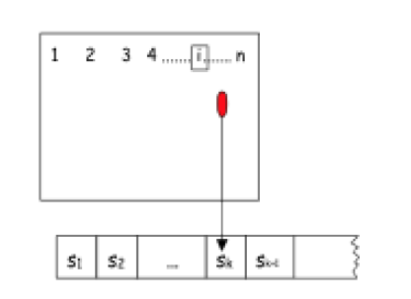
A Turiing Machine

Slide 3
Transitions
Reads, Writes, Moves
Moves can be: R, L, S: For Right, Left, Stay

Slide 4
Special states
Initial State:
Halt:
Halt
Normal stop. However, the transition function is partial, so it can also stop if there are no viable transitions. It can also stop if it moves to the left of the initial postion.

Slide 5
Configuration
The tape is infinite, but what we are reading is not. The tape contains symbols and blanks. What we are interested is what is not blanck.
The configuration contains:
The first cells of the tape after which there are only blanks
The position of the reader
The state
Execution continues until we:
Reach halt
No transition is applicable
Fell off the left of the tape
When used to recognize languages, the TM writes Y if the string is accepted (it may write N, if it’s not accepted, but its not necessary)

Slide 6
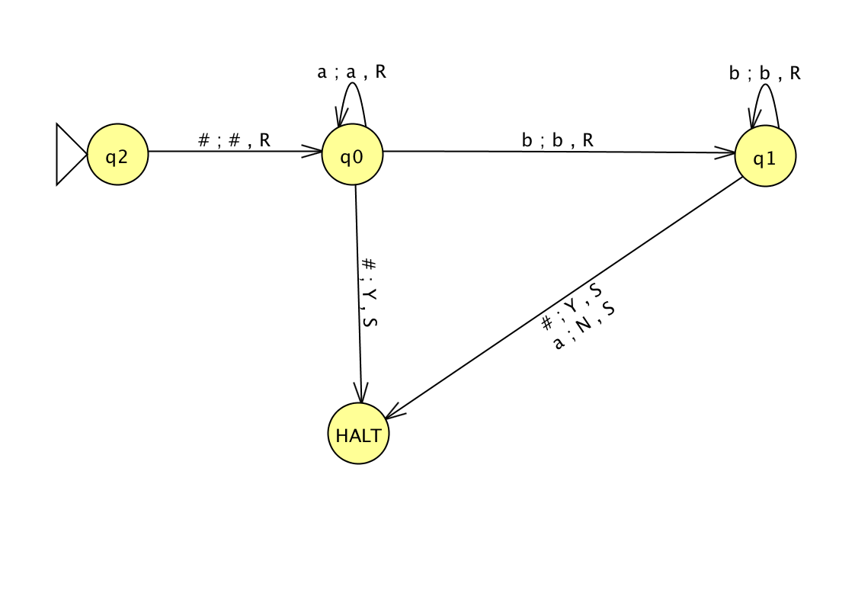
#a*b*

Slide 7
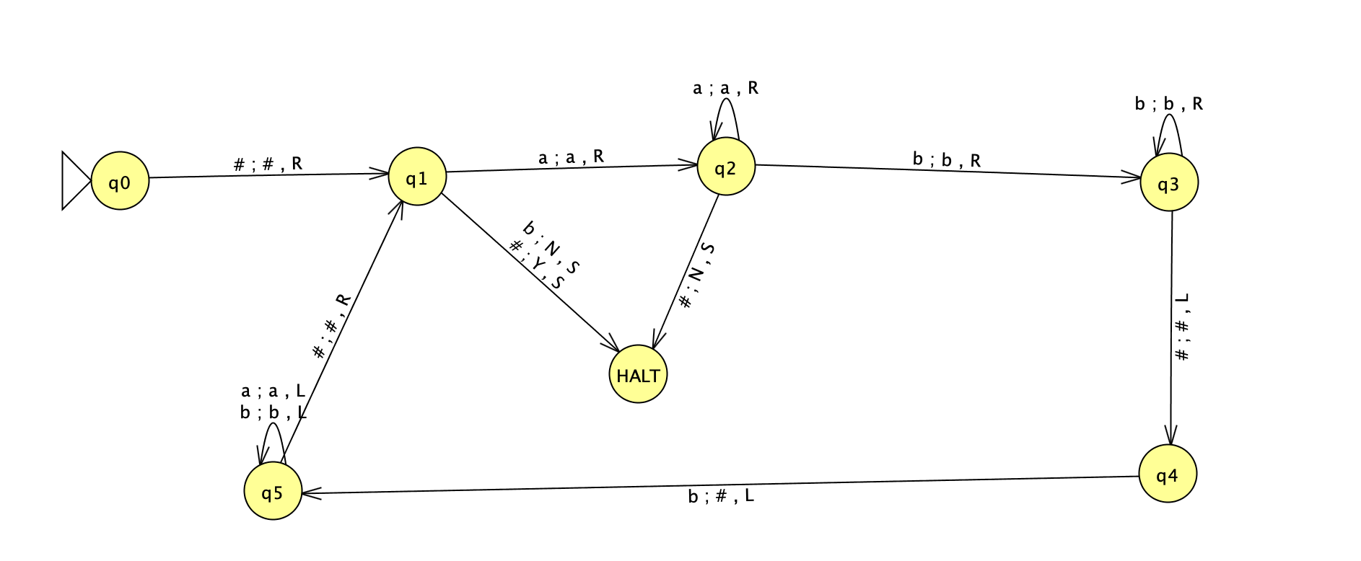
{#a^{n}b^{n}: n >= 0}

Slide 8
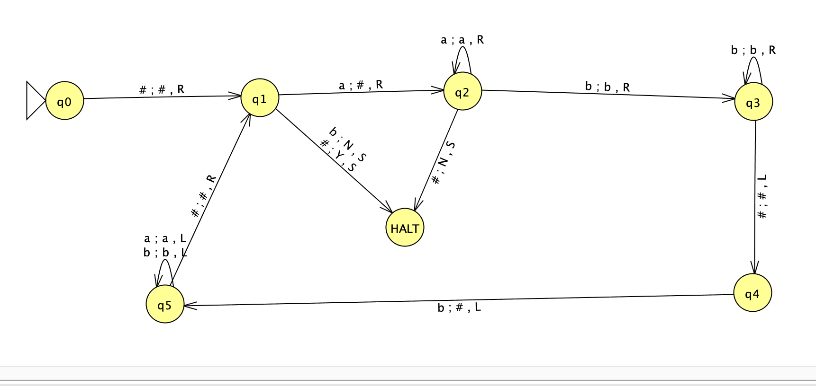
{#a^{n}b^{n}: n >= 0}

Slide 9
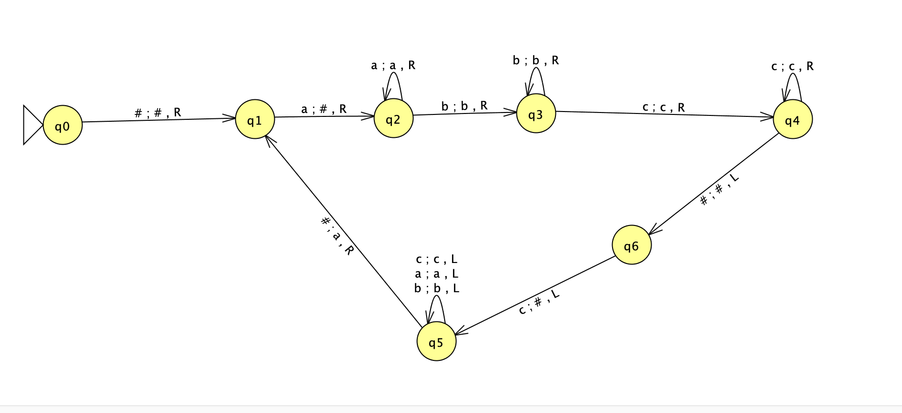
{#a^{n}b^{n}c^{n}: n >= 0}. First attempt

Slide 10
{#a^{n}b^{n}c^{n}: n >= 0}. First attempt
Start: q0,#aaaabbbbcccc
End: q1,#aaaabbbb

Slide 11
{#a^{n}b^{n}c^{n}: n >= 0}. What can we do??
Start: q0,#aaaabbbbcccc
End: q1,#aaaabbbb

Slide 12
{#a^{n}b^{n}c^{n}: n >= 0}. What can we do??
Start: q0,#aaaabbbbcccc
End: q1,#aaaabbbb
Return to the beginning and recognize {#a^{n}b^{n}: n>=0}

Slide 13
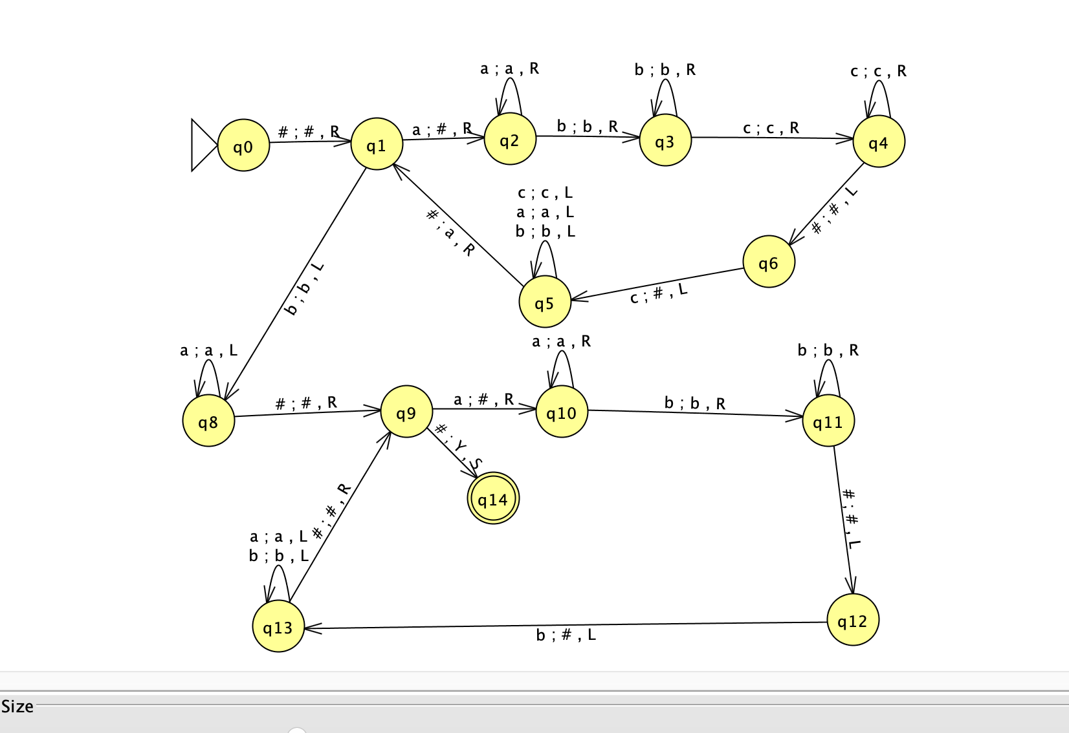
{#a^{n}b^{n}c^{n}: n >= 0}.

Slide 14
{#w$w: w in {a,b}*}
It is useful to think about steps in the computation
#aabb$aabb
#aabb$aabb
##abb$aabb
##abb$$abb
###bb$$abb
###bb$$$bb
####b$$$bb
####b$$$$b
#####$$$$b
#####$$$$$

Slide 15
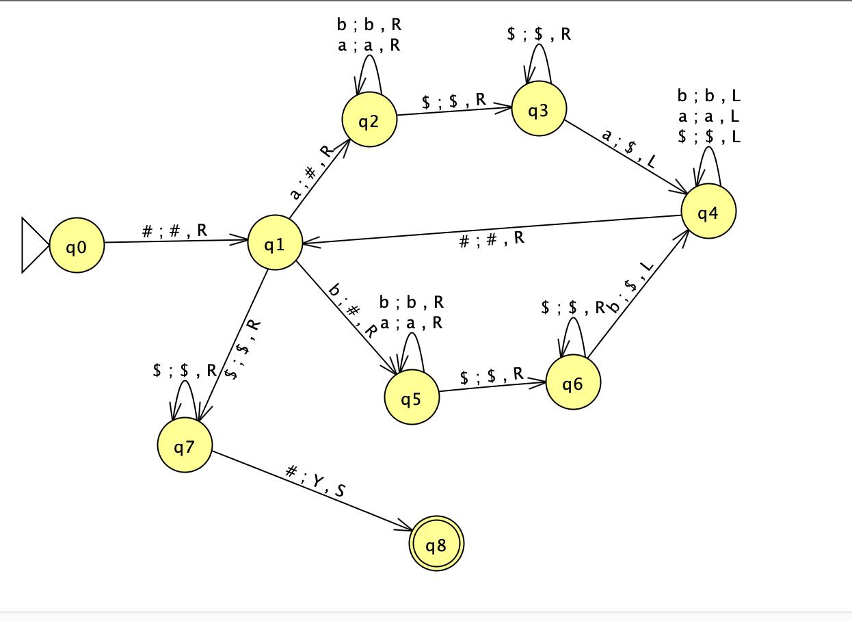
Is Copy

Slide 16
Split a string (the string’s length should be even
#abbabb#
##bbabb#
##bbab#b
##bbab#b
##bbab#b
#abbab#b
…
#abba#bb

Slide 17
Split a string (the string’s length should be even
#abbabb#
##bbabb#
##bbab#b
##bbab#b
##bbab#b
#abbab#b
…
#abba#bb
#ab#a#bb
#ab#a#bb
#ab##abb
#ab##abb
#abb#abb
#abb$abb

Slide 18
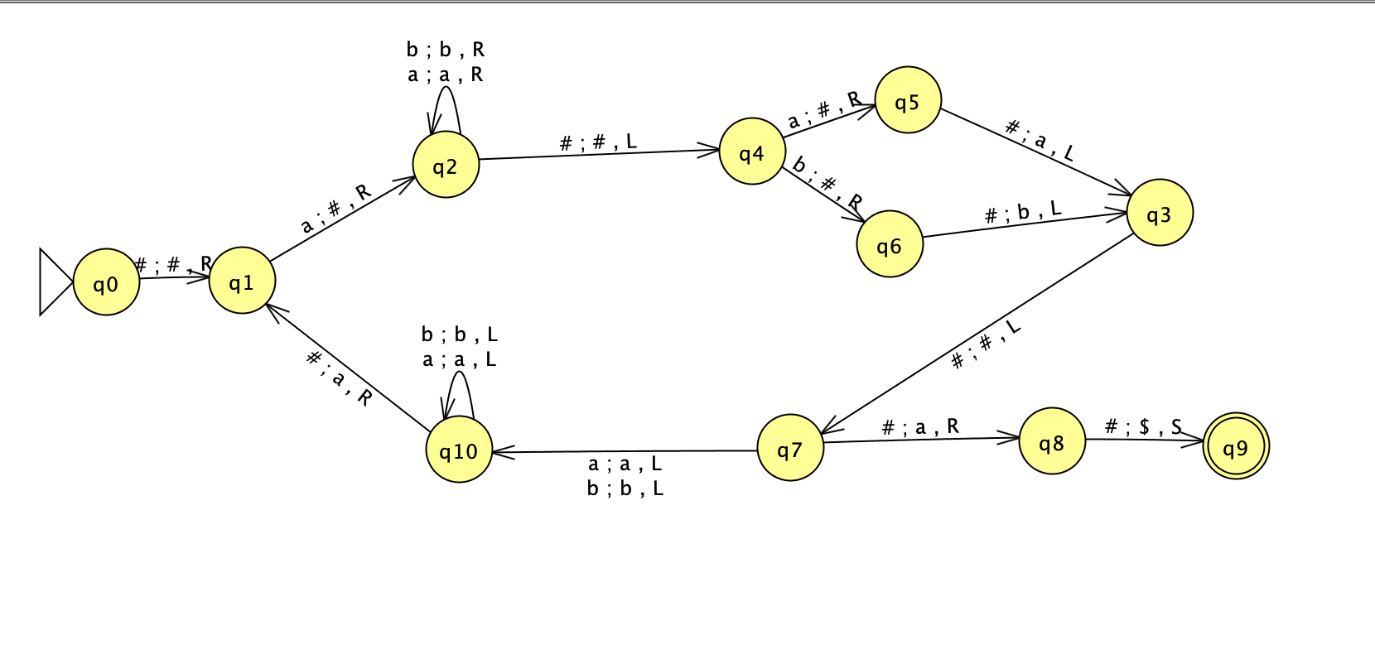
Split…. only for a…. For now

Slide 19
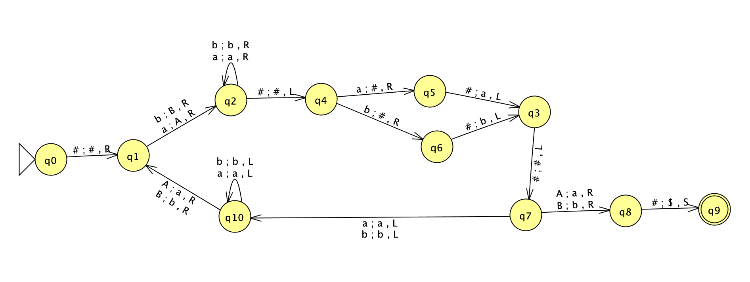
But to deal with b… we need another branch
Unless we mark a with A and b with B !!!

